Slide 1

SENTIMENT ANALYSIS OF TWEETS DURING THE KENYA ELECTIONS 2022

Slide 2

TEAM MEMBERS
MAGDALINE ALUKHAVA
JANET CHESEREM
ANGELA OGADA
YVES HAVUGIMANA
POLYCARP OSORO

Slide 3

PROBLEM STATEMENT
With the growing impact of social media in political campaigns, it is important to understand the extent to which Twitter influences the outcome of presidential elections in Kenya.
While studies have shown that social media can play a significant role in shaping public opinion, there is a need to investigate the impact of Twitter specifically, and whether it can be used as a reliable predictor of election results.

Slide 4
OBJECTIVE OF THE STUDY
The objective of this study is to study the sentiments of twitter users during presidential elections in Kenya and its potential impact on the election outcome.
The following specific objectives will be addressed:
To study twitter users based on their tweets to determine their political party preference
To segment twitter users into distinct groups based on their political party preference
To provide insights into the influence of social media on election campaigns and identify any patterns or trends that emerge.

Slide 5
SENTIMENT ANALYSIS
User Tweet Ruto Polarity
sentiment
Negative 327 327 327 327
Positive 853 853 853 853
User Tweet Raila Polarity
sentiment
Negative 320 320 320 320
Positive 860 860 860 860

Slide 6
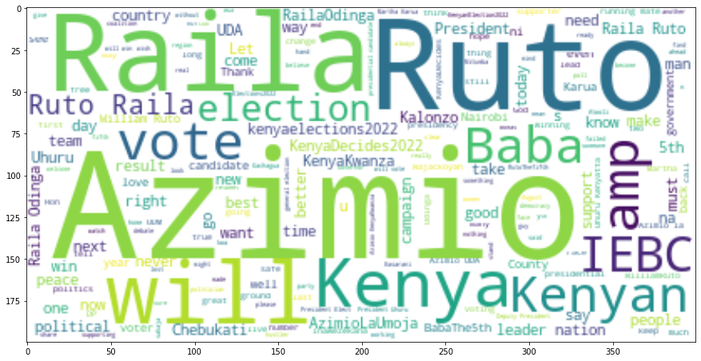
VISUALIZATION ON CLOUD OF WORDS

Slide 7
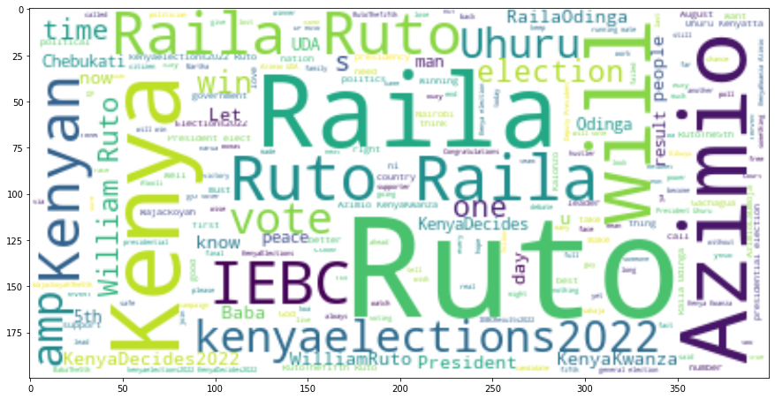
VISUALIZATION ON CLOUD OF WORDS

Slide 8
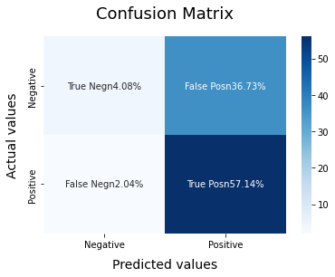

Slide 9
